Slide 1
Application of piezoelectric phenomena in exploration
Speaker: Wan Ru Liao

Slide 2
Outline
Principle-What is Piezoelectricity?
Application-How to use?
Conclusions-What is different?

Slide 3
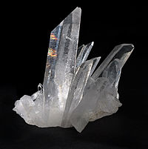
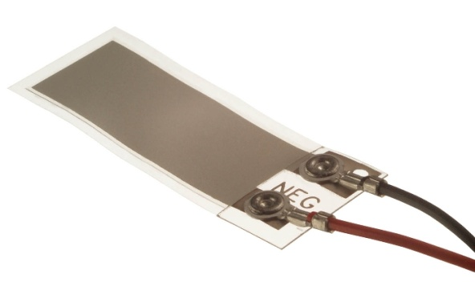
What is Piezoelectricity?
Piezoelectricity is the mechanical energy exchange for electrical energy.
Piezoelectric materials are
natural and artificial, like
quartz and PVDF.

Slide 4
Equation
P：Electric susceptibility(C/m²)
d：Piezoelectric constant(C/N)
σ：Stress (N/m²)
P = dσ

Slide 5
Ore-quartz zone in Yakutia, Russia
Arrary figure shows an observation scheme for ground surveys using the piezoelectric method.
The conventional piezoelectric measurements are performed using electrodes.
There is gold-bearing quartz depositat.

Slide 6
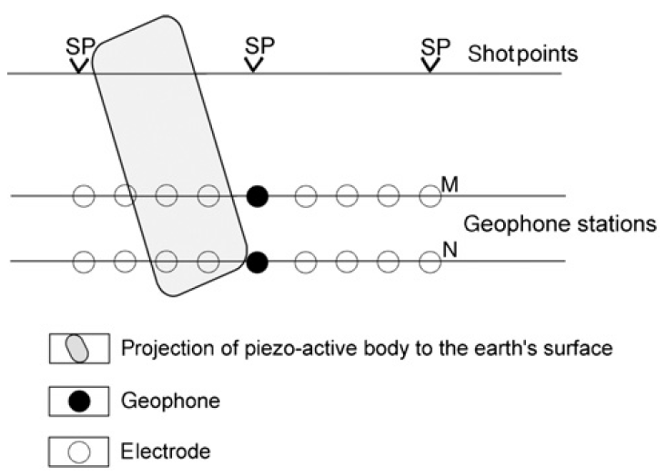
Piezoelectric measurement array

Slide 7
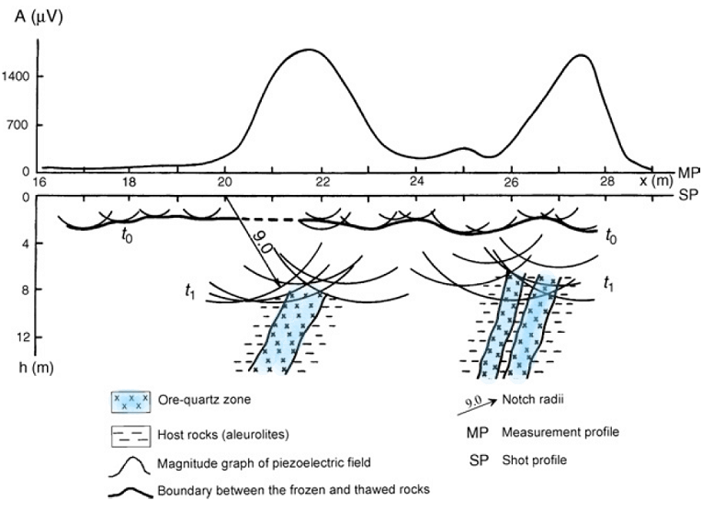
Piezoelectric measurements

Slide 8
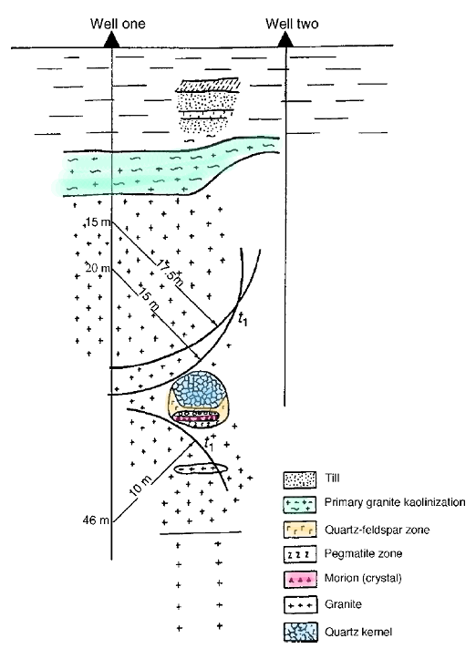
Crystal-bearing pegmatites in northern Ukraine
The piezoelectric method was applied to localize and delineate blind pegmatite bodies occurring in granites.

Slide 9
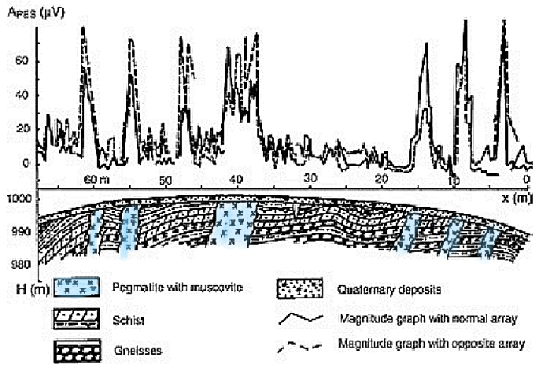
Muscovite deposits in Russia

Slide 10
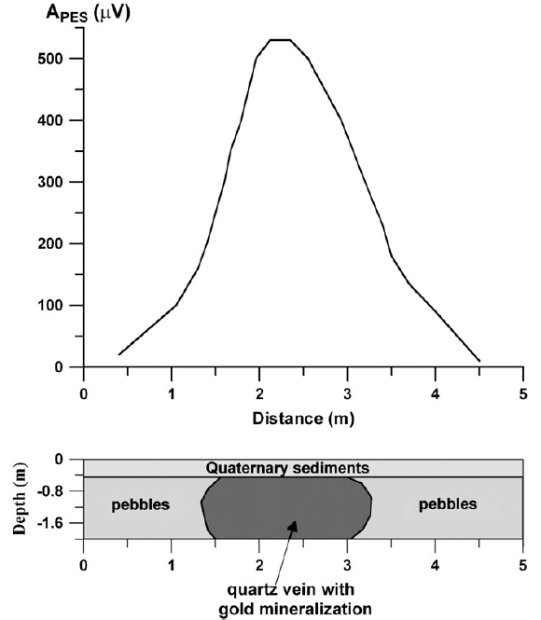
Gold-bearing mine in Israel

Slide 11
Conclusions
piezoelectric
precision
drilling
slow
fast
approximate
expensive
cheap
high piezoactivity
any matter

Slide 12
Reference
Neishtadt, N. M., Eppelbaum, L. V., & Levitski, A. G. (2006). Application of piezoelectric and seismoelectrokinetic phenomena in exploration geophysics: Review of Russian and Israeli experiences. Geophysics, 71(2), B41-B53.
Eppelbaum, L. V., Khesin, B. E., & Itkis, S. E. (2010). Archaeological geophysics in arid environments: Examples from Israel. Journal of Arid Environments, 74(7), 849-860.

Slide 13
Thank you for your listening.

